Slide 1

Predicting Accident Severity
Steven Harpham
Data Science Career Track
08/26/2021

Slide 2
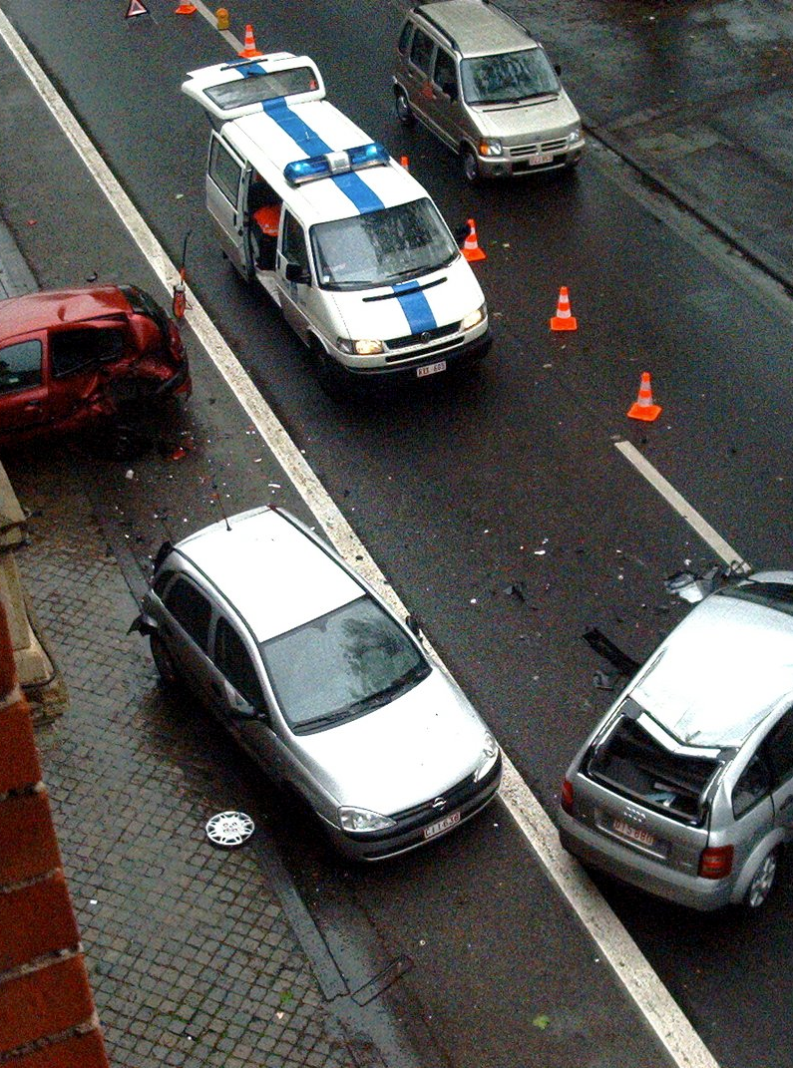
Overview
Problem Identification/Data Selection
Data Wrangling
Data Cleaning/Preprossesing
Modeling

Slide 3
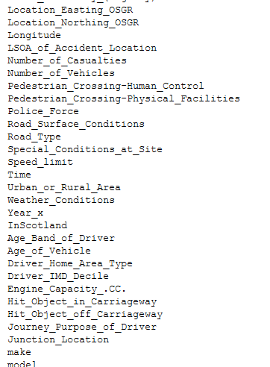
Problem Identification
UK. GOV/ Kaggle Data Source
Dataset – accidents 2004-2016
Contains 57 Features/ ~2 million Rows

Slide 4
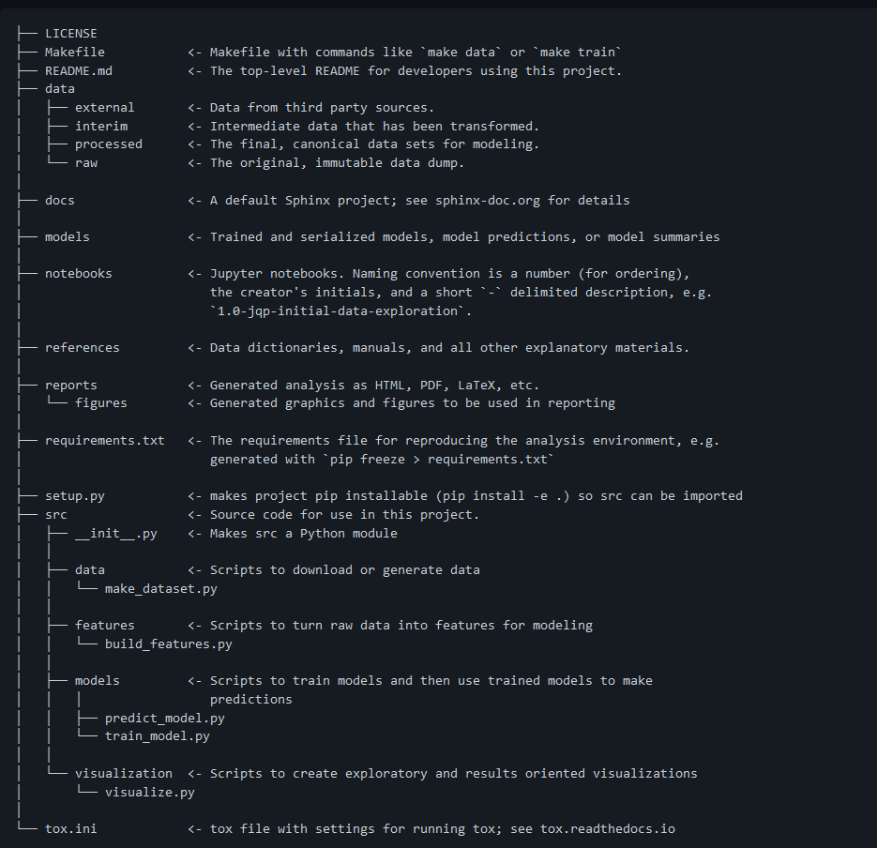
Organization
Virtual Environment
CookieCutter
Github

Slide 5
Wrangling/Cleaning
Dropping Nulls
Impute others
Feature Selection (those present before or during accident)
Drop location based variables

Slide 6
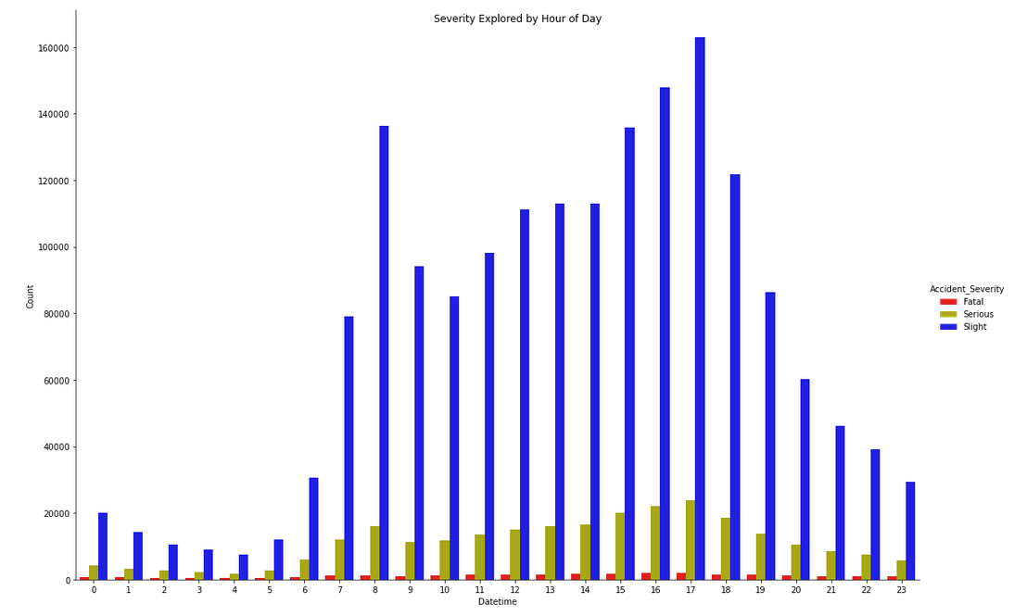
EDA
56 features Vs Severity(3 target levels)
Selected Visualizations

Slide 7
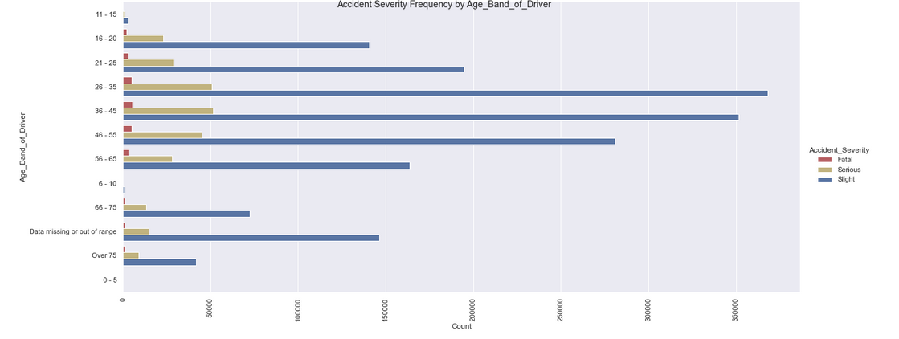
Age Band vs Severity

Slide 8
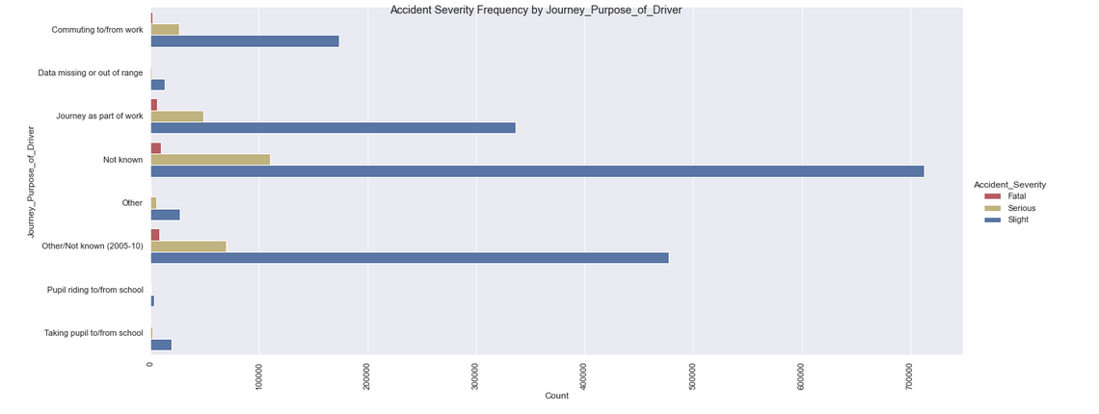
Journey Purpose

Slide 9
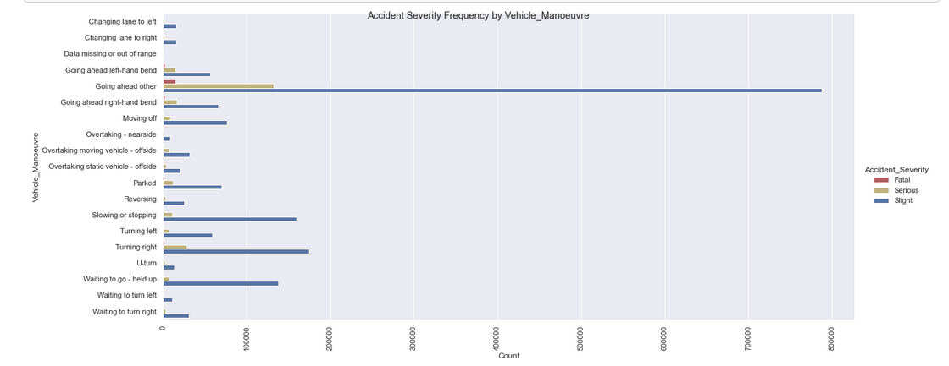
Vehicle Manoeuvre

Slide 10
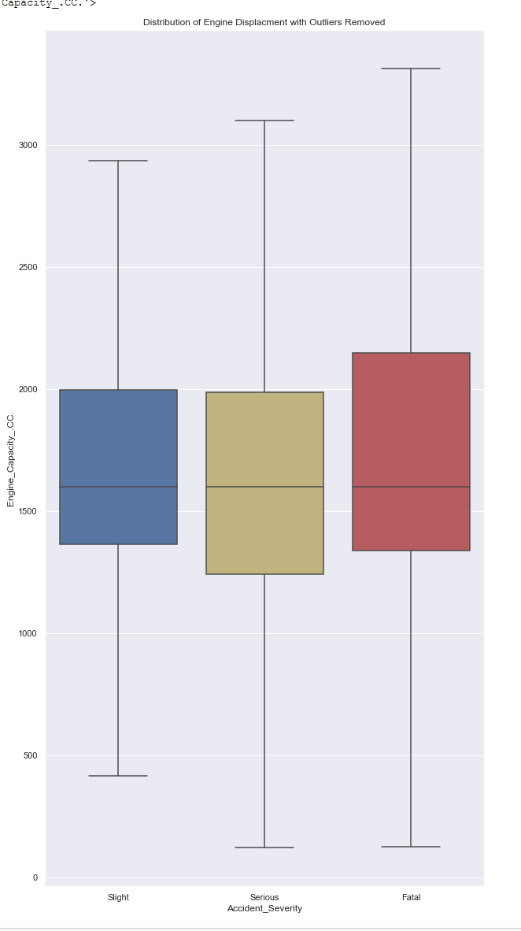
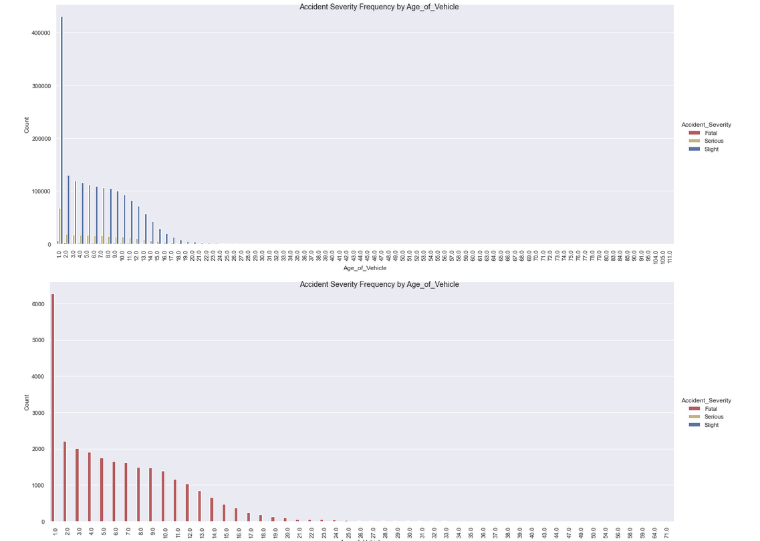
EDA examples

Slide 11
Modeling
Logistic - 2 types (Binary – Fatal/Non-Fatal), and multiclass
Random Forest – Binary and Multiclass
XGBoost - Binary
SMOTE – Synthetic and Multiclass

Slide 12
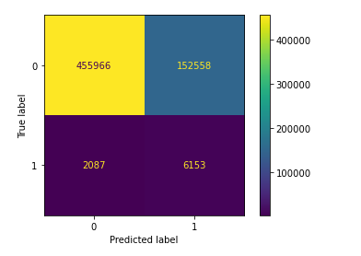
Best Binary Model ( Fatal or Non-Fatal )
Logistic – Fatal or Non-Fatal
 | precision | recall | f1-score | support
Not Fatal | 0.995444 | 0.749298 | 0.855008 | 608524.000000
Fatal | 0.038769 | 0.746723 | 0.073710 | 8240.000000
accuracy | 0.749264

Slide 13
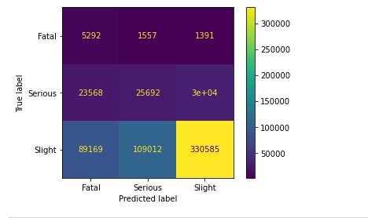
Best Multiclass Model
Logistic w/one vs. rest – Fatal, Severe, Slight
 | precision | recall | f1-score | support
Fatal | 0.044836 | 0.642233 | 0.083821 | 8240.000000
Serious | 0.188550 | 0.322124 | 0.237868 | 79758.000000
Slight | 0.912024 | 0.625201 | 0.741854 | 528766.000000
accuracy | 0.586236

Slide 14
Discussion/Use Cases
In vehicle/live prediction
Suggest a different time to leave etc.
Insurance Company
Call center – Call prioritization
inference about:
Caller vehicle
Caller age
Emergency Response
Call prioritization based in inferred characteristics of caller

Slide 15
Further Research/Ideas
Many other modeling methods to try(XGBoost again, KNN etc.)
Possibly go back and include some location-based data
More cleaning of (unknown/missing) values

